Slide 1
The War Begins 1939 - 1940

Slide 2
Appeasement Fails
The Allies pursued a policy of appeasement in the hope of avoiding war. In the end, this policy was a complete failure.
Germany Rearms
Rhineland Reoccupied
WAR
The Anschluss
Munich Agreement
Rome-Berlin Axis
Soviet-German Pact
Poland Invaded

Slide 3
Map Animation
Go to the website:
the-map-as-history.com
Login info: provided by teacher
Click on the section, “World War II”
Watch the following map animation:
Moving Towards War
The Map as History

Slide 4
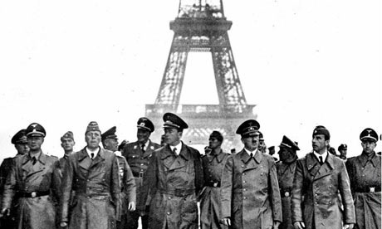
Lecture outline
The Allies Mobilize
The “Phoney War”
Blitzkrieg
The Spring of 1940
The Miracle at Dunkirk
The Defense of France
The Occupation of France

Slide 5
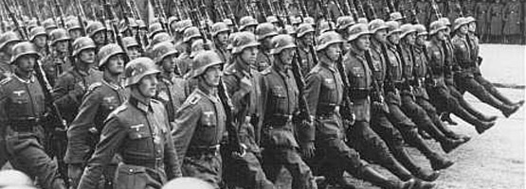
The Allies Mobilize
After the German invasion of Poland (Sept. 1, 1939) Britain and France ordered Germany to withdraw or war would be declared.
The Germans refused and WW II began on September 3, 1939.

Slide 6
The “Phoney War”
Upon the declaration of war it was expected that Germany would invade the rest of Europe.
However, nothing happened during the winter of 1939/1940. Journalists labeled this new conflict the “Phoney War.”

Slide 7
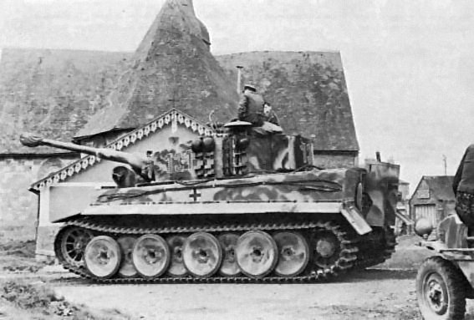
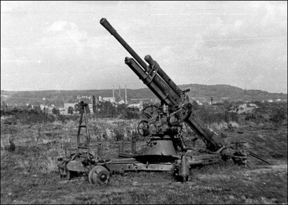
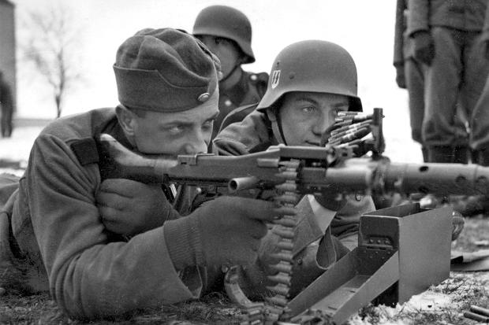
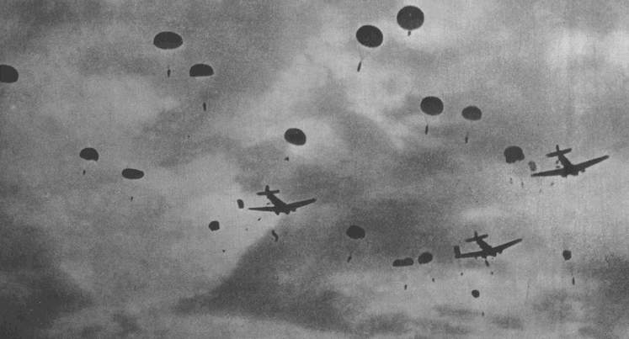
Blitzkrieg
In the spring of 1940 the German war machine renewed its attack upon the rest of Europe.
They used a new tactic called, “Blitzkrieg.”
A quick overwhelming attack that used all aspects of the military.

Slide 8
The Spring of 1940
Countries invaded by Germany in the spring of 1940 (in order):
Denmark and Norway
Netherlands and Belgium
France

Slide 9
The Miracle at Dunkirk
As the Germans advanced into France they encircled over 400,000 Allied troops (British and French).
With the Germans approaching nearly all of the troops were evacuated from Dunkirk to Dover.

Slide 10
Primary Video Footage: The Miracle at Dunkirk
To re-imbed the video clip search the following in YouTube:
British Dunkirk Evacuation Footage- Operation Dynamo 1940
Notes:
http://www.youtube.com/watch?v=SSoDLfQKhGI

Slide 11
The Defense of France
During the inter-war period France had prepared for a potential German invasion by building the Maginot Line.
A fortified system of underground tunnels and artillery along the French-German border.

Slide 12
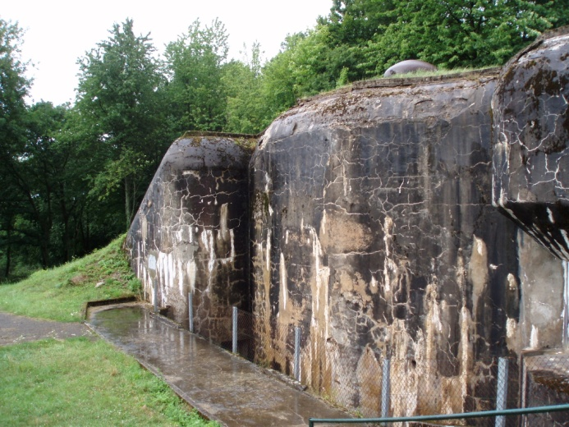
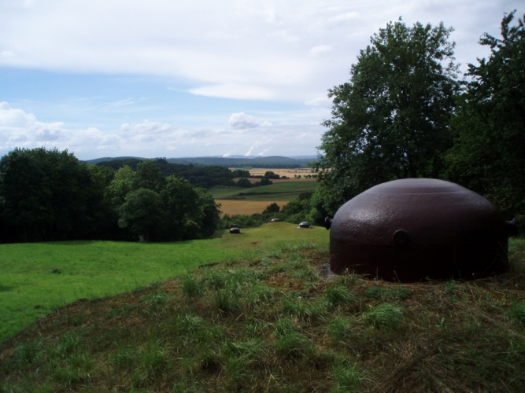
The Maginot Line

Slide 13
The Occupation of France
Ultimately, the Maginot Line failed to prevent a German invasion and after 6 weeks of fighting France surrendered on June 22, 1940.
The northern portion of France was occupied while the southern portion remained “independent” and was renamed “Vichy France.”

Slide 14
The division of France

Slide 15
The End of the Beginning
The “Phoney War” was indeed over as Hitler invaded much of Western Europe in the Spring of 1940.
He would soon set his sights on new objectives, namely, Britain, Russia and North Africa.
For those living under German occupation life would drastically change and liberation would take many years.

